Slide 1

SMART WATER FOUNTAINS
Team mentor: Prabhu
Team leader: sainanthan J
Team members
Rahul prasanth
Yogesh
Sujith
Soundara pandiaan

Slide 2
Objective:
Our goal is to design a smart water fountain that can monitor the water quality and automatically replace water when polluted(not healthy) or running out. We will use sensors to measure the waterquality.
Considering the pollution at home can only affect limited factors, we choose temperature, Ph-value and conductance to be the three properties used for calculating water quality in our water fountain

Slide 3
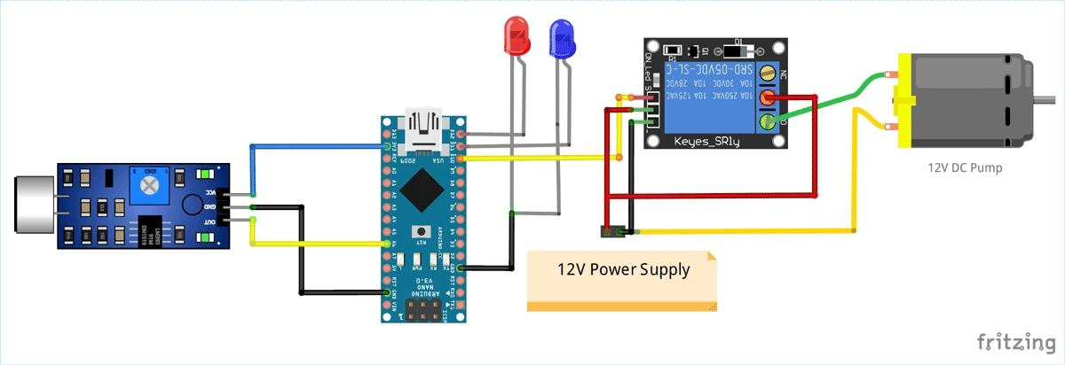
Design:

Slide 4
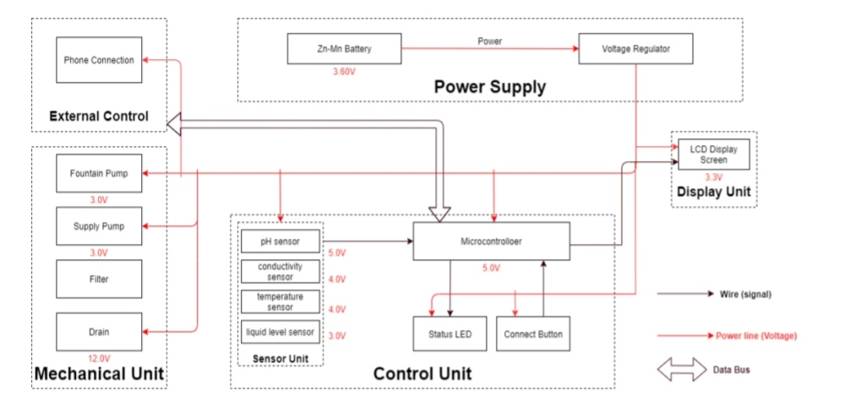
BLOCK DIAGRAM:

Slide 5

Sensor Unit:
Temperature Sensor
PH-sensor
Conductivity sensor
Liquid Level Sensor
Power Supply Unit:
Zn-Mn Battery
Voltage regulator

Slide 6


